Slide 1
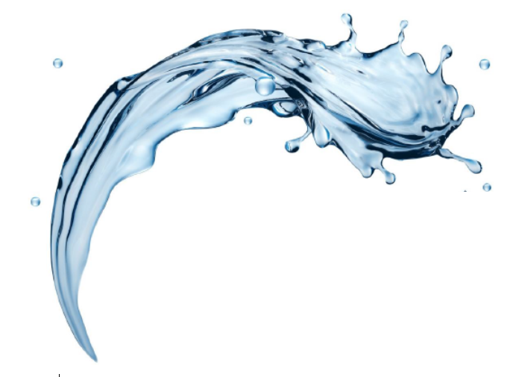

FilterSorb SP3
Treatment Methode: Part II
-by Deepak Chopra
1

Slide 2

CaCO3+H2O+CO2
Treatment Method Of
Corrosion and Scale
Formation
CaCO3+ H2O + CO2
with controlled pH adjustment
by
Filtersorb SP3
„All corrosion and scale formation is water chemistry and distribution systems are controlled by pH, alkalinity and CO2 in water.“

Slide 3
Background
The water utilities in the whole world have a tremendous investment in the miles of pipes, valves, showers, heaters, boilers, cooling towers and all other appurtenances in water distribution systems in Residential, Industrial and Commercial applications. The replacement cost of these systems are estimated at 500 billion Euros. In addition each home, building served by utilities has additional piping and expensive equipments like coffee machines, espresso machines, dishwashers, washing machines and hot water boilers. all these systems are full of deposits of scale and corrosion incrustation.

Slide 4
Water Hardness
“Water hardness” is commonly confused with alkalinity (the total concentration of base). The confusion relates to the term used to report both measures, mg/L of CaCO3. If limestone is responsible for both Hardness and alkalinity, the concentrations will be similar if not identical. However, where SODIUM-BICARBONATE (NaHCO3) is responsible [FACT] for alkalinity it is possible to have low or high hardness with little or no alkalinity. Is it not strange? NaHCO3 is the main cause of low alkalinity and it's a [FACT].

Slide 5
Alkalinity and Scale formation
HIGHER THE ALKALINITY HIGHER THE SCALE POTENTIAL
High bicarbonate alkalinity in soft water is produced by sodium and potassium carbonates which are more which are more soluble than calcium and magnesium carbonates that cause hardness. If Ca, Mg and FILTERSORB SP3 produce calcium carbonate (CaCO3) crystals, the pH present in the water remain same because gentle nucleation reaction on SP3 surface, no dramatic pH increase or decrease because of limestone is formed. The bases associated with ALKALINITY react with released CO2 and buffer pH changes. The pH of well buffered water is always between 7.2 - 7.6. In water treated with TAC with high and intense aggressive surface can reach dangerously low pH of 6.5 , causing corrosion.

Slide 6
Acidic Water
Metals such as Copper, Lead, Zinc are used for all piping systems. The metals more soluble in acidic environment and acidic water. The soluble FREE IONIC forms of all these metals are very toxic to human and animal life. High concentrations of Calcium and magnesium (bicarbonate hardness) prevents this effect [case study] of copper, Lead and Zinc at their sites of toxic action. Therefore Copper, Lead and Zinc are more toxic to all living organisms in soft water [case study] , acidic water with low total alkalinity.
Ideally Surface water, Ground water or in any kind drinking water sources it should have a pH between 7.2 - 7.6 as well as moderate to high total alkalinity (150 - 300 mg/L, but never less than 100 mg/L) and a CaCO3 hardness of 200 mg/L to 400 ml/L. All the principals of chemistry (bicarbonate-carbonate) buffering are explained using a fundamental understanding
pH | Co2 | and | hardness of water
which is necessary for effective and healthful life of "all human beings". There is no way to avoid it ; Watch Water Quality is "WATER CHEMISTRY“.

Slide 7
Scale and Corrosion
Either
CORROSION or
SCALE or
both increase in head loss through the lines and a major increase in pumping costs. The worst effect of corrosion is after using the water softeners. Every water softeners will bring "RED WATER" at household taps. This rusty water contains hydrated iron hydroxide suspended as particles and cause the water to turn "RED". It causes staining of household appliances and clothes laundered in such water is also stained. Since the water is used for human consumption, CORROSION of metals such as IRON, LEAD, and COPPER caused by WATER SOFTENER cannot be used.

Slide 8
Treatment Method
The only method for economical protection which can be applied is the adjustment of the "High Water Quality" so that a thin deposit of CALCIUM- CARBONATE develops in the pipes. And this requires
ADJUSTMENT OF THE pH
of the water to a point it is containing crystals of “CALCIUM CARBONATE“
using FILTERSORB SP3 and corrosion is retarded by the film of "CALCIUM CARBONATE", but the deposit will not interfere with the flow.
ION EXCHANGE resins such as Strong ACID Cation or Weak ACID cation With SODIUM CHLORIDES and HYDROGEN CHLORIDES which have been used to regenerate resins are the major cause of corrosion in water treatment.
Case study ………using sodium chlorides
Case study ………using hydrochloric acid
CALCIUM CARBONATE is not soluble in water but only soluble in acids.

Slide 9
pH Adjustment
A
A
High till pH 1
B
B
pH7
Low till pH 0 More OH-Ions
Nucleation (NAC)
pH 7.2 – 7.6
Figure 1
A. pH and carbon dioxide [FACT] The pH which indicates whether water is acidic (low) or basic (high). pH indicates the hydrogen ion concentration in water and is defined as the negative logarithm of the molar hydrogen ion concentration (-log[H+]). Water is considered acidic when pH is below 7 (TAC) and basic when pH is above 7 (NAC). Most pH value encountered fall between 6.8 and 6.5. The recommended pH range for (healthy water) is 7.2 to 7.6 (Figure 1). Human body have an average blood pH of 7.4.

Slide 10
Alkalinity
The CO₂ mixed in the ground water or atmosphere reacts with water, producing carbonic acid (H₂CO₃) and pH is lowered.
H₂O + CO₂ ↔ H2CO₃ ↔ H+ + HCO3-
FILTERSORB SP3 helps reducing excess CO₂ by improving its diffusion back to the atmosphere. High CO2 levels can be treated with SP3 without using any chemicals.
B. Alkalinity and carbon dioxide (CO₂)
The quality of base (OH-) present in water defines what is known as total alkalinity. Common bases found in Hard Water include bicarbonates (HCO₃),(OH-) Hydroxides, Phosphates and berates. Bicarbonates (HCO₃) and Hydroxides (OH) are the major cause of alkalinity. Alkalinity is measured by the amount of acid (Hydrogen ion) water can adsorb (buffer) before achieving a designated pH . Total alkalinity is expressed as milligrams per liter calcium carbonate (mg/L of CaCO₃), the most desirable range of total alkalinity for all human life is between 120 and 300 mg/liter CaCO₃.

Slide 11
Alkalinity
Ca+2 and bicarbonate HCO3- forming Ca(HCO3)2 in surface water and well water is produced primarily through CO2 + H2O + CaCO3 = Ca(HCO3)
MORE PRECISELY B
Rain water (H2O) is naturally acidic because of exposure to atmospheric carbon dioxide (CO2). As rain falls to the earth, each droplet becomes saturated with CO2 and pH is lowered. Typically all ground waters have high CO2 concentrations and low pH and very less oxygen concentrations. “Higher the CO2 lesser the oxygen” (High respiration). Carbon dioxide is high in underground water or surface water or pond water because of bacterial processes in the soil and various underground waters, particulate mineral formations through which water moves.

Slide 12
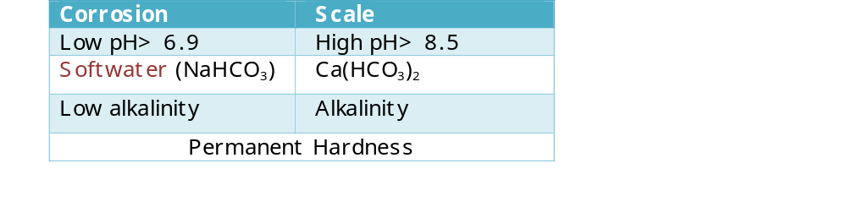
Conclusion
As Ground or Surface water flow over and percolate through soil and underground rock formations containing calcite and dolomite lime stone [CaMg(CO3)2], the acidity produced by CO2 will dissolve lime stone and form calcium and magnesium bicarbonate salts.
The resultant: CaMg(CO3)2 + H2O + 2CO2 = Ca+2 + Mg+2 + 4HCO3-
OR
CaCO3 + H2O + CO2 = Ca(HCO3)2
Water has increased alkalinity, pH and CO2
Causes of corrosion and scale
End of Part I
Thanks for reading!

Slide 13
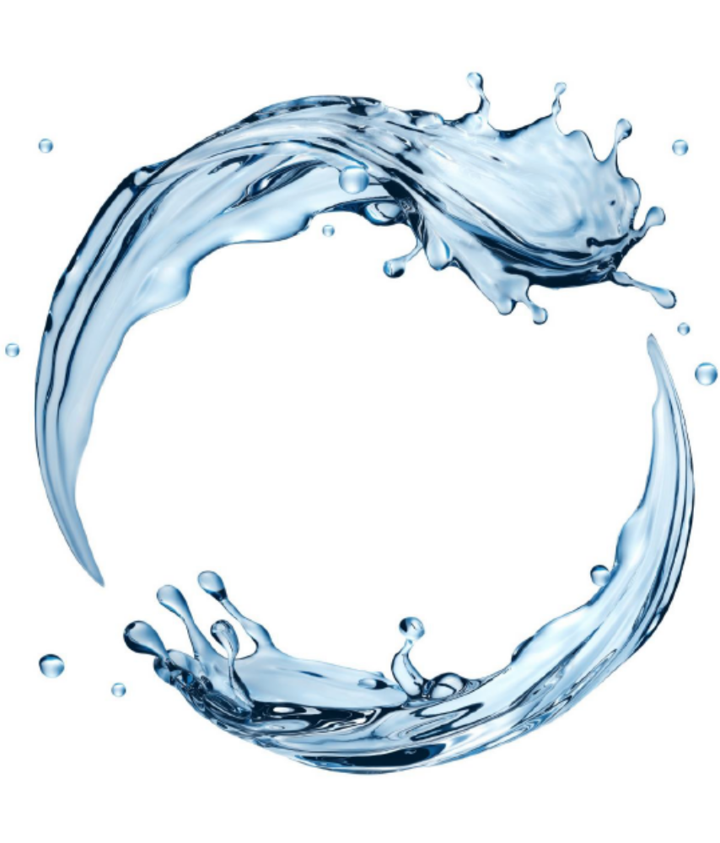

Watch Water® GmbH
Fahrlachstraße 14
68165 Mannheim
Germany
www.watchwater.de
info@watchwater.de
+49 (o)621 87951-0

